Slide 1


Kubernetes for Continuous Integration
Agile Brains Consulting
‹#›
©Agile Brains Consulting Inc. All rights reserved. Not to be reproduced without prior written consent.

Slide 2
Table of Content
Scaling and autoscaling
Deployment Strategies
Rolling update
Recreate
Blue Green
Canary
Service Discovery

Slide 3
Zero Downtime Scaling
Agile Brains Consulting
‹#›
©Agile Brains Consulting Inc. All rights reserved. Not to be reproduced without prior written consent.

Slide 4
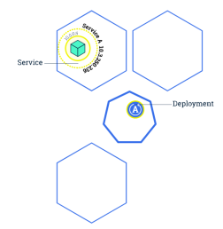
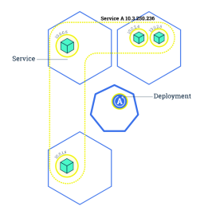
Kubernetes: Scaling
Changing the number of resources to meet a desired state
Accomplished by adjusting the number of replicas in a deployment
Accommodates both scaling up and scaling down to a minimum of 0
Traffic is automatically sent to newly created instances through the service load balancer
Can be used to enable rolling updates without downtime
Agile Brains Consulting
‹#›
©Agile Brains Consulting Inc. All rights reserved. Not to be reproduced without prior written consent.

Slide 5
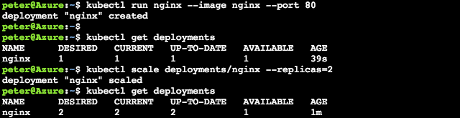
$ kubectl scale deployments/<deployment> --replicas=<new num>
$ kubectl scale deploy/nginx --replicas=4
Note: Make sure to delete the deployments or replicasets when trying to clear out pods. Many a new user has repeated deleted pods and gotten frustrated when they respawn (as the deployments/replicasets are programed to do).
Agile Brains Consulting
‹#›
©Agile Brains Consulting Inc. All rights reserved. Not to be reproduced without prior written consent.
Notes:
kubectl run nginx –image nginx –port 80
kubectl get deployments
kubectl scale deployments/nginx –replicas=2
kubectl get deployments
http://kubernetesbyexample.com/labels/

Slide 6
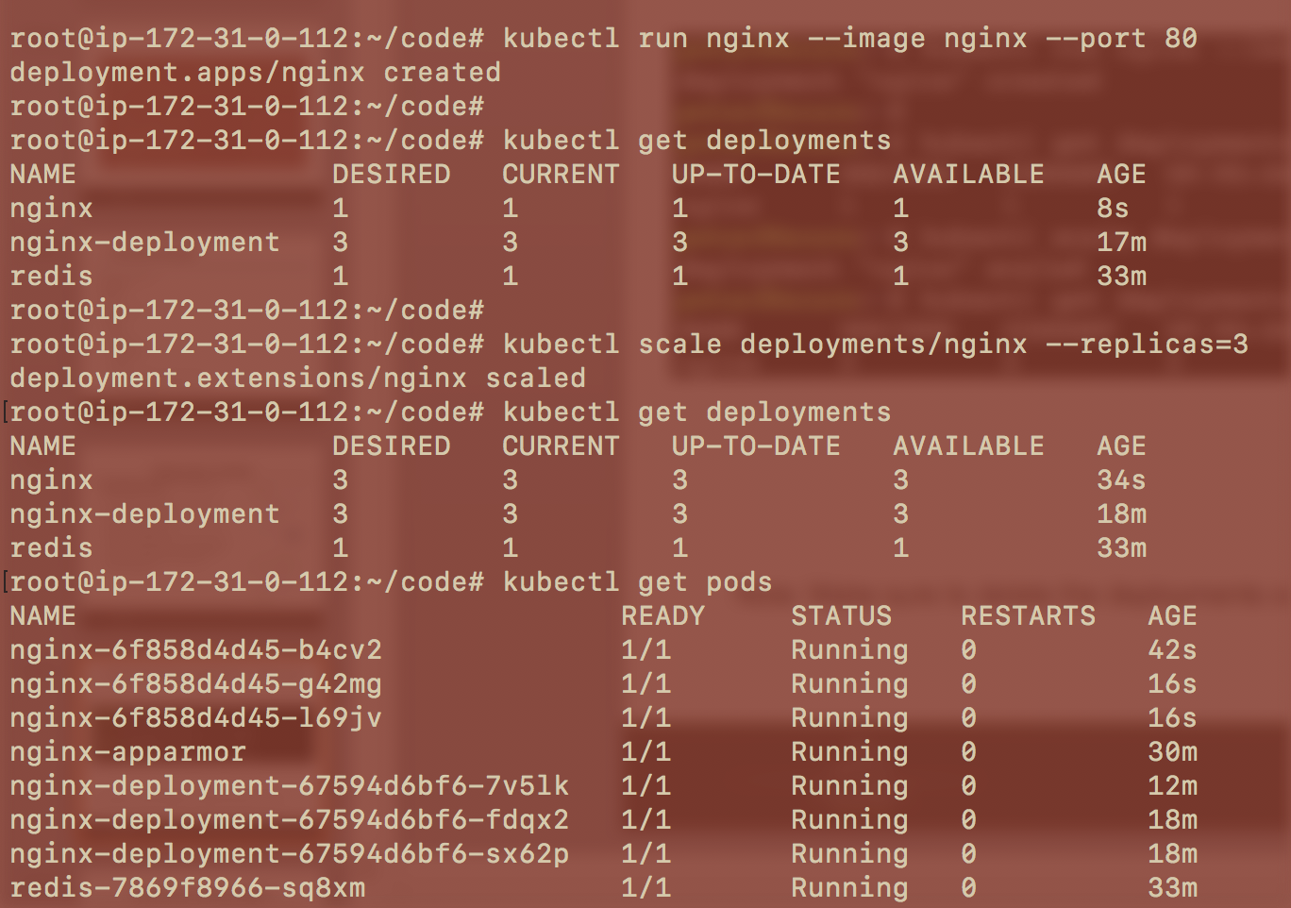
Agile Brains Consulting
‹#›
©Agile Brains Consulting Inc. All rights reserved. Not to be reproduced without prior written consent.
Notes:
kubectl run nginx –image nginx –port 80
kubectl get deployments
kubectl scale deployments/nginx –replicas=2
kubectl get deployments
http://kubernetesbyexample.com/labels/

Slide 7
Autoscaling and HPA (Horizontal Pod Autoscaler)
Agile Brains Consulting
‹#›
©Agile Brains Consulting Inc. All rights reserved. Not to be reproduced without prior written consent.

Slide 8
Kubernetes: Pod Auto Scaling
HPA – Horizontal Pod Autoscaler:
Based on memory and CPU utilization by a pod, autoscaling scales up or down the number of pods
$ kubectl autoscale deployment nginx --min=2 --max=10
$ kubectl autoscale deployment nginx-deployment --max=5 --cpu-percent=80
$ kubectl get hpa
$ kubectl get hpa
NAME REFERENCE TARGETS MINPODS MAXPODS REPLICAS AGE
nginx Deployment/nginx <unknown>/80% 1 4 3 12m
nginx-deployment Deployment/nginx-deployment <unknown>/80% 2 5 0 5s
Agile Brains Consulting
‹#›
©Agile Brains Consulting Inc. All rights reserved. Not to be reproduced without prior written consent.

Slide 9
Kubernetes: Cluster AutoScaler
Adds or removes Nodes in a Cluster based on resource requests from Pods and to meet workloads
Possible only in cloud:
AWS, GCE, Azure, etc.
When does auto scale up kicked in?
Pods not getting scheduled and # nodes within user-defined limit
Agile Brains Consulting
‹#›
©Agile Brains Consulting Inc. All rights reserved. Not to be reproduced without prior written consent.

Slide 10
Kubernetes: Cluster AutoScaler
When does auto scale down kicked in?
Pod requests on a node lower than a user-defined threshold
Checks performed on each pod in the node
Pod runs a DaemonSet – it’s safe
Removing the pod does not bring down minimum number of replica
Pod doesn’t use local storage
Kube-system pods are not moved
Agile Brains Consulting
‹#›
©Agile Brains Consulting Inc. All rights reserved. Not to be reproduced without prior written consent.

Slide 11
Continuous Deployment Strategies
Agile Brains Consulting
‹#›
©Agile Brains Consulting Inc. All rights reserved. Not to be reproduced without prior written consent.

Slide 12
Strategies
Able to reliably and safely deploy, rollback and orchestrate software.
List of strategies:
Recreate
Ramped (Rolling update) Deployments
Blue/Green Deployments
Canary Releases
Agile Brains Consulting
‹#›
©Agile Brains Consulting Inc. All rights reserved. Not to be reproduced without prior written consent.

Slide 13
Strategies - Recreate
Recreate –
spec:
replicas: 3
selector:
matchLabels:
app: my-app
strategy:
type: Recreate
spec:
containers:
- name: my-app
image: my-image
terminate all the running instances then recreate them with the newer version
application state entirely renewed
not a true continuous deployment strategy
downtime
conceptual simplicity
Agile Brains Consulting
‹#›
©Agile Brains Consulting Inc. All rights reserved. Not to be reproduced without prior written consent.

Slide 14
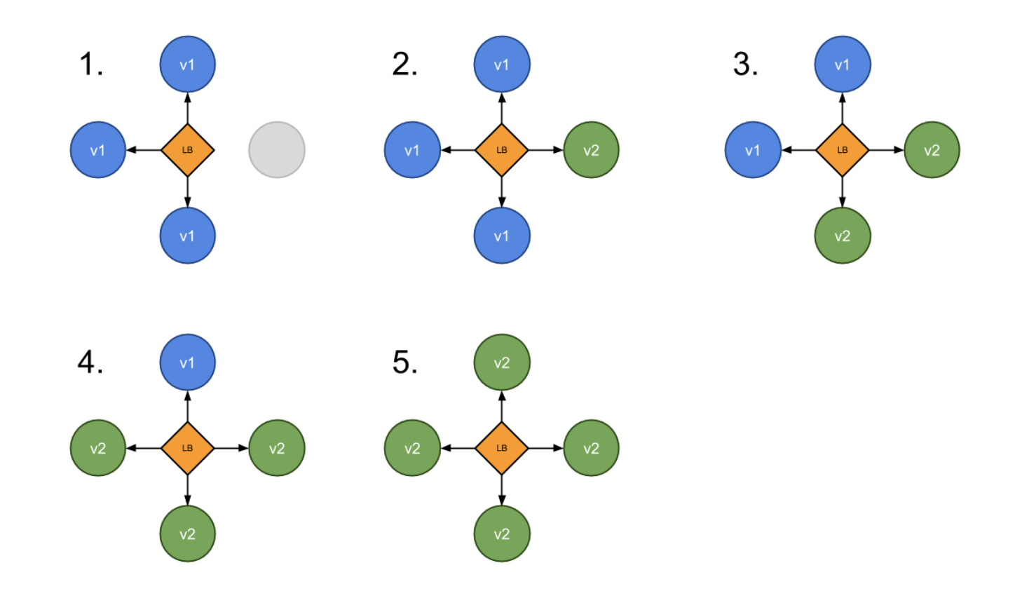
Strategies – Ramped or Rolling update
Ramped or Rolling Update
A secondary ReplicaSet is created with the new version of the application
The number of replicas of the old version is decreased and the new version is increased
Until the correct number of replicas is reached
Agile Brains Consulting
‹#›
©Agile Brains Consulting Inc. All rights reserved. Not to be reproduced without prior written consent.

Slide 15
Strategies – Ramped or Rolling update
Best Practice
Should be accompanied by some kind of a basic health check
To verify the new instances are ready to provide services
To avoid downtime
Keep in mind
The old and the new version run side by side.
Requires full backward compatibility of our API and schema changes
Careful API versioning whenever backward compatibility gets broken.
If deployment exposed as service, the service will load-balance traffic to only active and available pods
Agile Brains Consulting
‹#›
©Agile Brains Consulting Inc. All rights reserved. Not to be reproduced without prior written consent.

Slide 16
Strategies – Ramped or Rolling update
spec:
replicas: 3
strategy:
type: RollingUpdate
rollingUpdate:
maxSurge: 2 or x% # max number of pods can be created over desired
maxUnavailable: 1 or x% # define how many pods can be unavailable
containers: - image: nginx:2.0
readinessProbe: # when the container is ready to accept traffic httpGet: path: / port: 8080 initialDelaySeconds: 5 periodSeconds: 5 successThreshold: 1
Agile Brains Consulting
‹#›
©Agile Brains Consulting Inc. All rights reserved. Not to be reproduced without prior written consent.

Slide 17
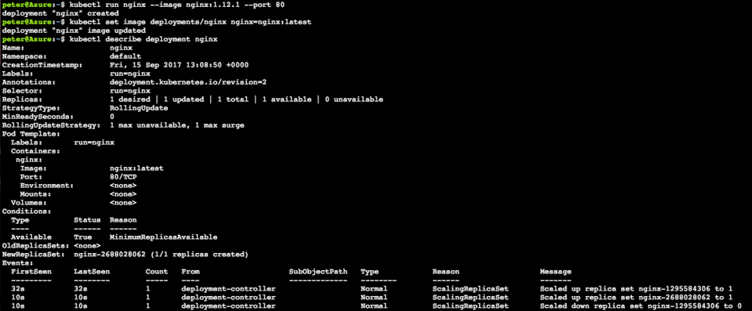
$ kubectl set image <deployment> <new-image>
Note: Rolling updates can also be undone
Agile Brains Consulting
‹#›
©Agile Brains Consulting Inc. All rights reserved. Not to be reproduced without prior written consent.
Notes:
Stand up nginx but with an older version, 1.12.1
1. kubectl run nginx --image nginx:1.12.1 --port 80
Set image to the newer version (latest). This triggers kubernetes to begin a rolling update
2. kubectl set image deployments/nginx nginx=nginx:latest
Observe the newer image has been rolled out
3. kubectl describe deployment nginx

Slide 18
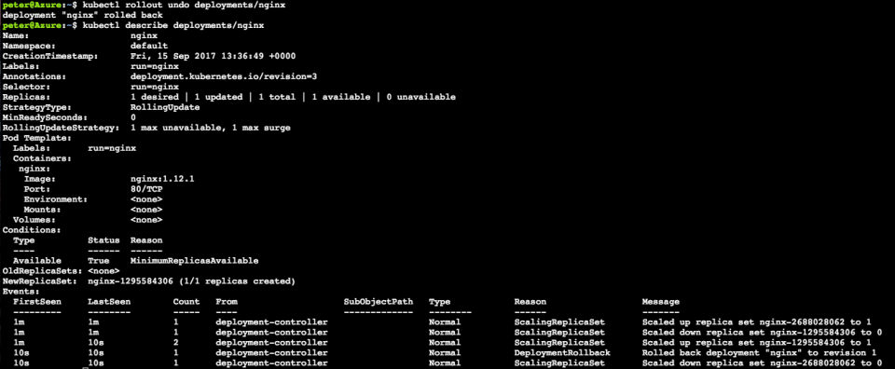
$ kubectl rollout undo <deployment>
Note: Rollbacks can also be also enacted with zero-downtime
Agile Brains Consulting
‹#›
©Agile Brains Consulting Inc. All rights reserved. Not to be reproduced without prior written consent.
Notes:
Roll back to previous version nginx 1.12.1
4. kubectl rollout undo deployments/nginx
Observe changes
5. kubectl describe deployments/nginx

Slide 19
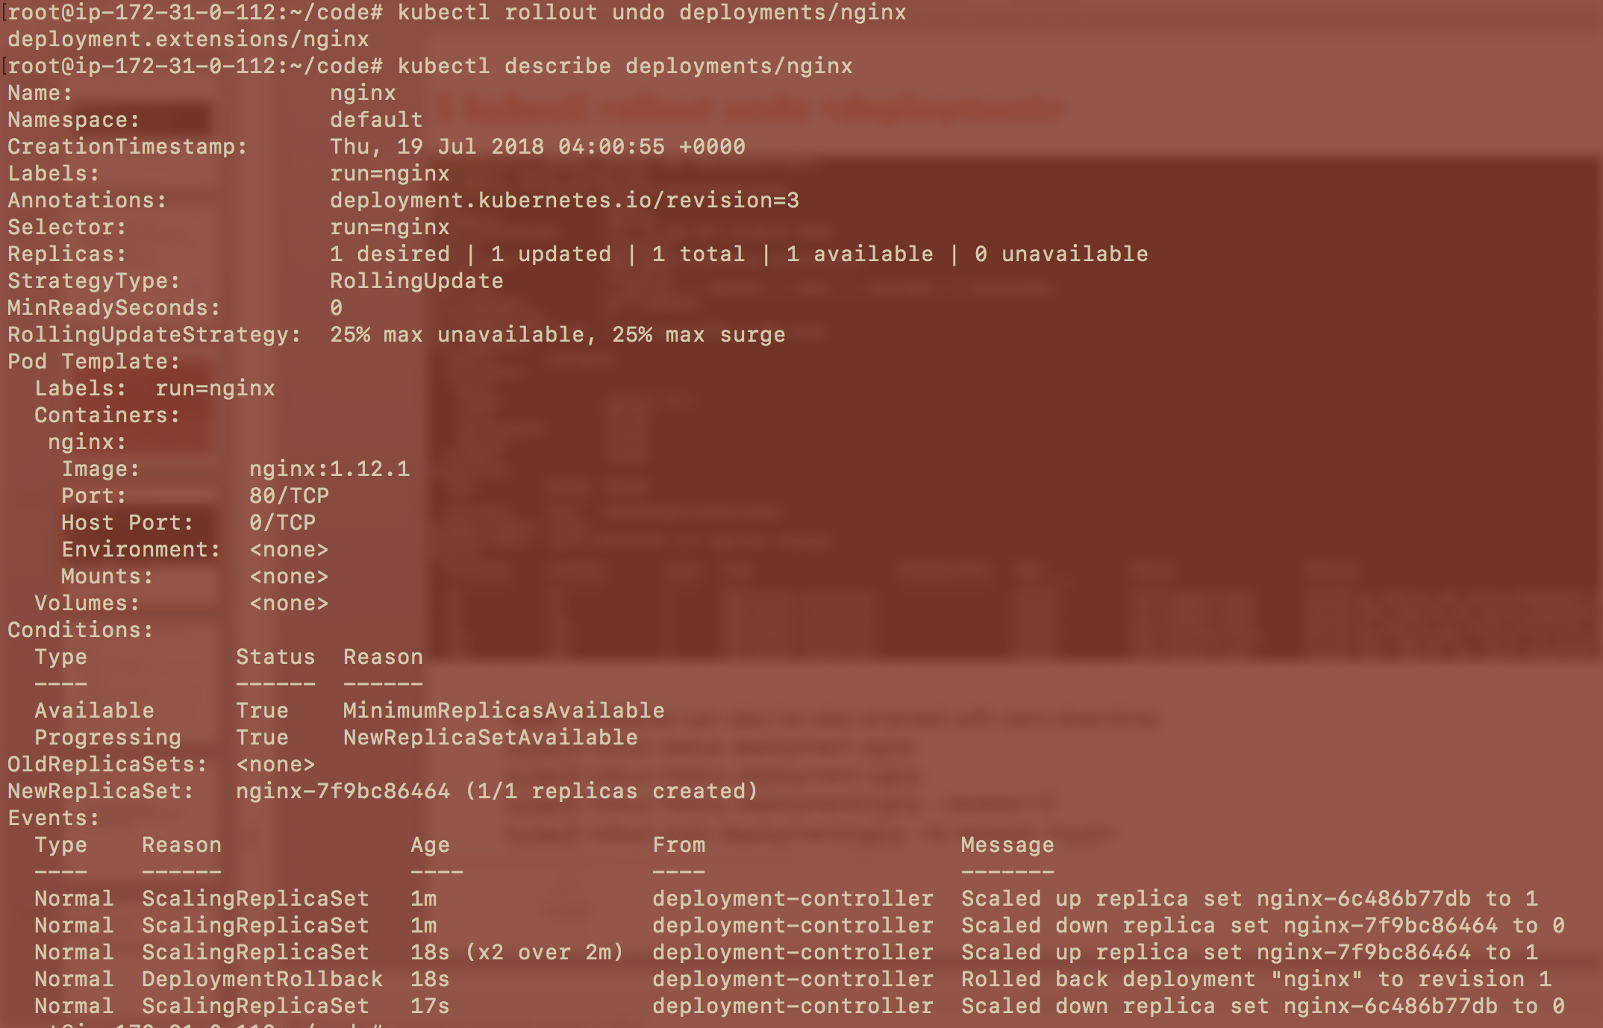
kubectl rollout status deployment nginx
kubectl rollout history deployment nginx
kubectl rollout history deployment/nginx --revision=3
kubectl rollout undo deployment/nginx --to-revision <num>
Agile Brains Consulting
‹#›
©Agile Brains Consulting Inc. All rights reserved. Not to be reproduced without prior written consent.
Notes:
Roll back to previous version nginx 1.12.1
4. kubectl rollout undo deployments/nginx
Observe changes
5. kubectl describe deployments/nginx

Slide 20
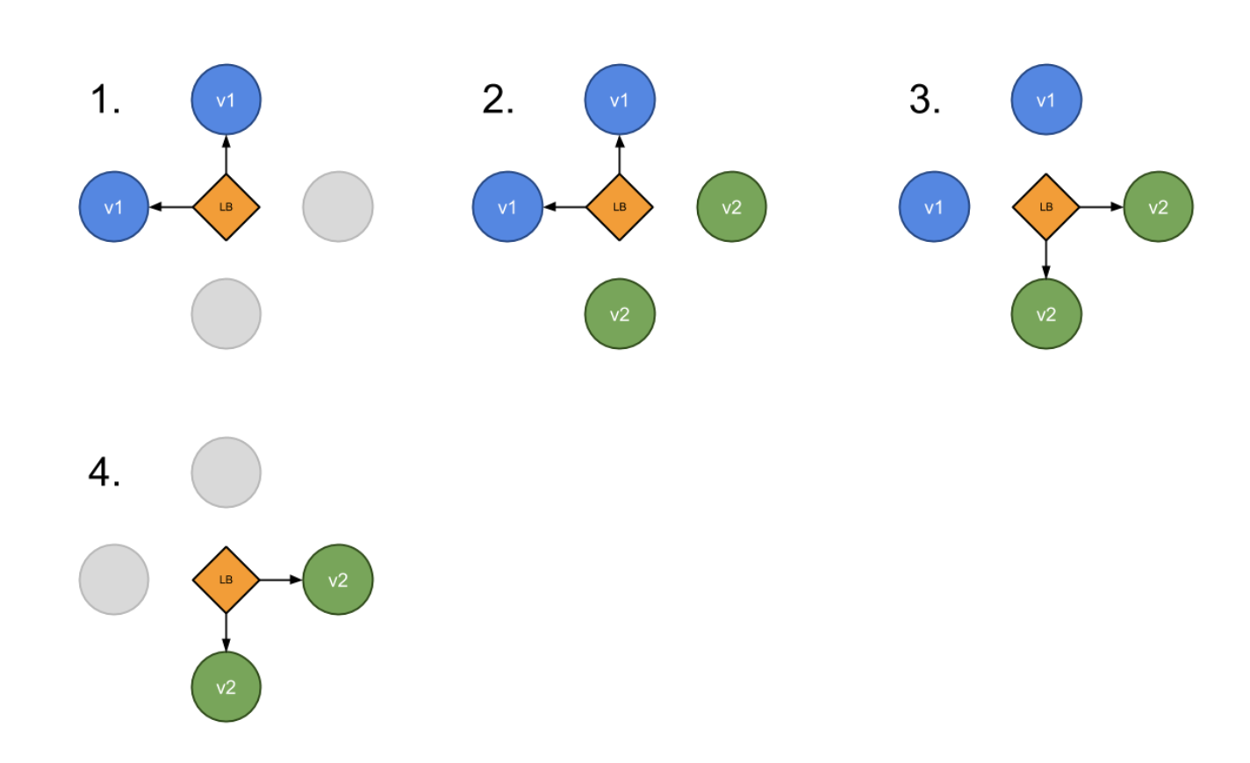
Strategies – Blue Green Deployment
“green” version is deployed alongside “blue”
Test the new version
Update the Service object (load balancer) to send traffic to the new version by replacing the version label in the selector field
Agile Brains Consulting
‹#›
©Agile Brains Consulting Inc. All rights reserved. Not to be reproduced without prior written consent.

Slide 21
Strategies – Blue Green Deployment
(-)
Requires double the resources
Proper test of the entire platform
(+)
No downtime
Easy rollback
Steps to follow
v1 is serving traffic
deploy v2
wait until v2 is ready
switch incoming traffic from v1 to v2
shutdown v1
Agile Brains Consulting
‹#›
©Agile Brains Consulting Inc. All rights reserved. Not to be reproduced without prior written consent.

Slide 22
kubectl apply -f my-dep-v1.yaml
kubectl apply -f my-dep-v2.yaml
my-dep v1
my-dep v2
After test
service
selector:
app: my-dep
version: v1
kubectl patch service my-app -p '{"spec":{"selector":{"version":"v2.0.0"}}}'
my-dep v2
my-dep v1
service
selector:
app: my-dep
version: v2

Slide 23
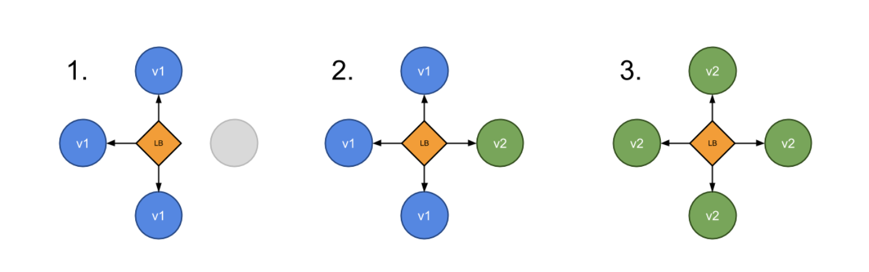
Strategies – Canary Deployment
Route a subset of users to a new functionality.
Can be done using two Deployments with common pod labels.
One replica of the new version is released alongside the old version
Then after some time and if no error is detected, scale up the number of replicas of the new version and delete the old deployment.
Agile Brains Consulting
‹#›
©Agile Brains Consulting Inc. All rights reserved. Not to be reproduced without prior written consent.

Slide 24
Strategies – Canary Deployment
(-)
Slow rollout
(+)
Fast rollback
Good for error rate & performance monitoring
Steps to follow
10 replicas of v1 is serving traffic
deploy 1 replicas v2 (meaning ~10% of traffic)
Wait enough time to confirm that v2 is stable and not throwing unexpected errors
scale up v2 replicas to 10
wait until all instances are ready
shutdown v1
Agile Brains Consulting
‹#›
©Agile Brains Consulting Inc. All rights reserved. Not to be reproduced without prior written consent.

Slide 25
kubectl apply -f my-dep-v1.yaml
kubectl apply -f my-dep-v2.yaml
my-dep v1
replica:10
my-dep v2
Replica:1
After sometime
selector:
app: my-dep
service
kubectl scale --replicas=10 deploy my-dep-v2
kubectl delete deploy my-dep-v1
my-dep v2
Replica:10
service
selector:
app: my-dep

Slide 26
Exercise 4 – (scaling, Auto scaling, rollout)
For a previously created deployment scale the number of replicas
see the difference in replicasets, pods , and see with a describe
Rolling update, undo and see the changes in replica sets
cd to the ex4
https://github.com/abhikbanerjee/kubernetes_teach_git/blob/master/ex4/scaling_rolling.md
Agile Brains Consulting
‹#›
©Agile Brains Consulting Inc. All rights reserved. Not to be reproduced without prior written consent.

Slide 27
Service Discovery
Agile Brains Consulting
‹#›
©Agile Brains Consulting Inc. All rights reserved. Not to be reproduced without prior written consent.
Notes:
https://fredjean.net/kubernetes-discovery/

Slide 28
Service Discovery
Migrating from a monolithic architecture to a Microservices based architecture where each service loosely coupled and horizontally scaled will require a service discovery mechanism to ensure that the REST API endpoints of the ephemeral services (say, docker containers running inside PODs) are resolved or detected. The IP addresses of the containers (or the PODs) being transient will need automated mechanism to resolve or convey the current IP addresses.
Agile Brains Consulting
‹#›
©Agile Brains Consulting Inc. All rights reserved. Not to be reproduced without prior written consent.
Notes:
https://fredjean.net/kubernetes-discovery/

Slide 29
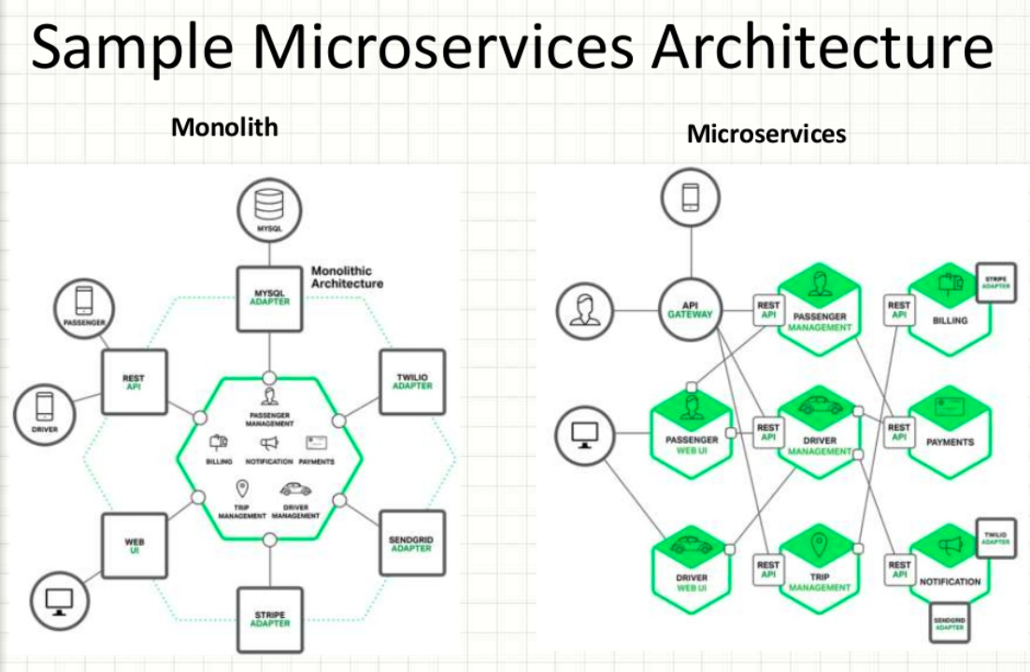
Agile Brains Consulting
‹#›
©Agile Brains Consulting Inc. All rights reserved. Not to be reproduced without prior written consent.

Slide 30

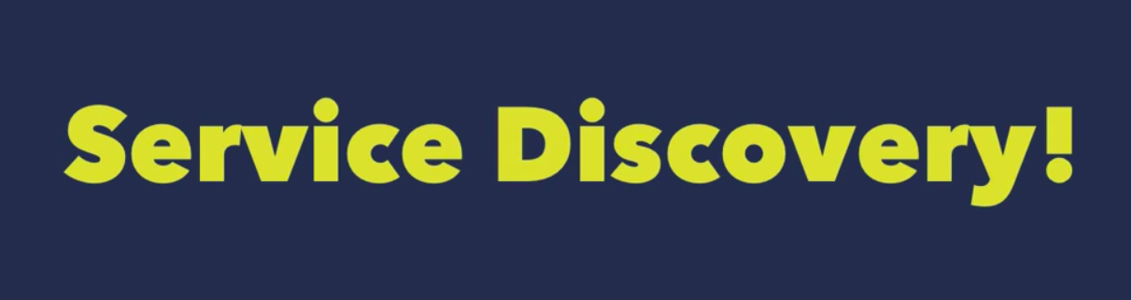
Service Discovery
Agile Brains Consulting
‹#›
©Agile Brains Consulting Inc. All rights reserved. Not to be reproduced without prior written consent.
Notes:
https://fredjean.net/kubernetes-discovery/

Slide 31
Service Discovery
What should Service Discovery provide?
Discover services dynamically to get IP address and port details to communicate with other services
Health check: Only healthy services should participate in handling traffic
Load balancing: Traffic destined to a particular service should be dynamically load balanced
Agile Brains Consulting
‹#›
©Agile Brains Consulting Inc. All rights reserved. Not to be reproduced without prior written consent.

Slide 32
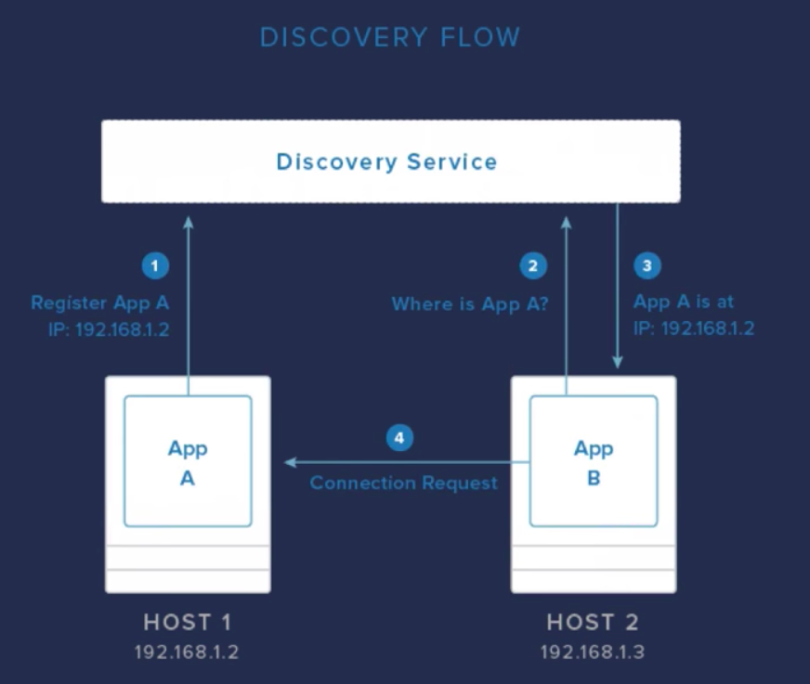
Service Discovery
Agile Brains Consulting
‹#›
©Agile Brains Consulting Inc. All rights reserved. Not to be reproduced without prior written consent.
Notes:
https://fredjean.net/kubernetes-discovery/

Slide 33
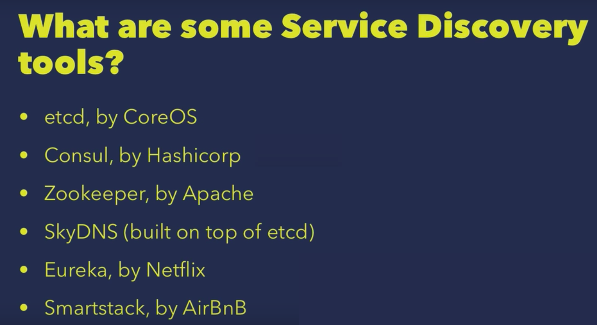
Service Discovery Tools
Agile Brains Consulting
‹#›
©Agile Brains Consulting Inc. All rights reserved. Not to be reproduced without prior written consent.
Notes:
https://fredjean.net/kubernetes-discovery/

Slide 34
Service Discovery by etcd
Etcd can be used as KV store for service registry
Service itself can directly update etcd or a Sidekick service can be used to update etcd
Sidekick service serves as registrator
Other services can query etcd database to do the dynamic service discovery
service
service
service
service
sidekick
etcd
Agile Brains Consulting
‹#›
©Agile Brains Consulting Inc. All rights reserved. Not to be reproduced without prior written consent.

Slide 35
Kubernetes Service Discovery
DNS Resolution
Kubernetes has a kube-dns addon that exposes the service’s name as a DNS entry. As a result, you can tell your application to connect to a host name.
The service names are scoped within namespaces. This allows you to run different deployment of a service for each namespace (for example, one per developer or one per environments) without having to edit configuration files.
Agile Brains Consulting
‹#›
©Agile Brains Consulting Inc. All rights reserved. Not to be reproduced without prior written consent.
Notes:
https://fredjean.net/kubernetes-discovery/

Slide 36
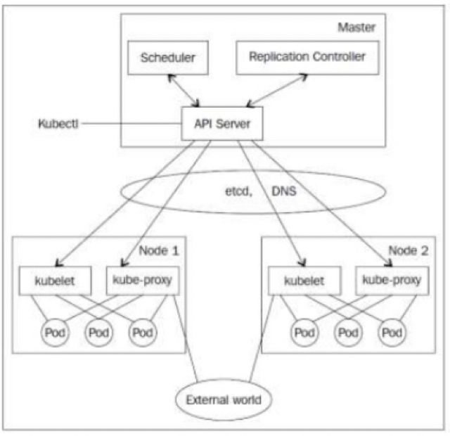
K8s Service Discovery Components
SkyDNS – map Service name to IP address
Etcd – KV store for service database
Kubelet – healthcheck and replication controller takes care of maintaining pod count
Kube-proxy – takes care of load balancing traffic to individual pods. Watches service changes and updates IPTables
Agile Brains Consulting
‹#›
©Agile Brains Consulting Inc. All rights reserved. Not to be reproduced without prior written consent.

Slide 37
Service Discovery
{
"kind": "Service",
"apiVersion": "v1",
"metadata": {"name": "my-service"},
"spec": {
"selector":{"app": "MyApp"},
"ports":[
{
"protocol":"TCP",
"port":80,
"targetPort":9376
}
]
}
}
Services – get mapped to pods using Selector labels. In the example: “MyApp” is the label
Service port gets mapped to targetPort in the pod
Agile Brains Consulting
‹#›
©Agile Brains Consulting Inc. All rights reserved. Not to be reproduced without prior written consent.

Slide 38
Lab: Service Discovery
https://github.com/abhikbanerjee/kubernetes_teach_git/blob/master/k8s_service_discovery/service-discovery.md
Example using consul:
https://github.com/hashicorp/demo-consul-101/tree/master/k8s
Agile Brains Consulting
‹#›
©Agile Brains Consulting Inc. All rights reserved. Not to be reproduced without prior written consent.

